Slide 1
FANCY DOING SOME DRAWING
AND
CREATING CHARACTERS?

Slide 2


HOUSE COMPETITION
ART
HOUSE COMPETITION 1 – YEAR 7 ONLY

Slide 3
TASK:
TO DESIGN A MASCOT/CHARACTER
FOR YOUR HOUSE
A4 max using the House colour mostly ie Hereward is red

Slide 4

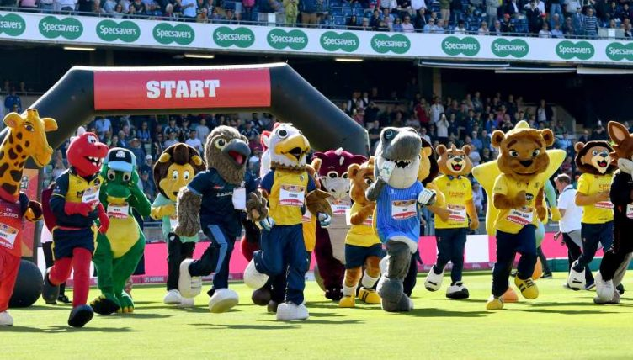
WHAT IS A MASCOT?

Slide 5


Slide 6
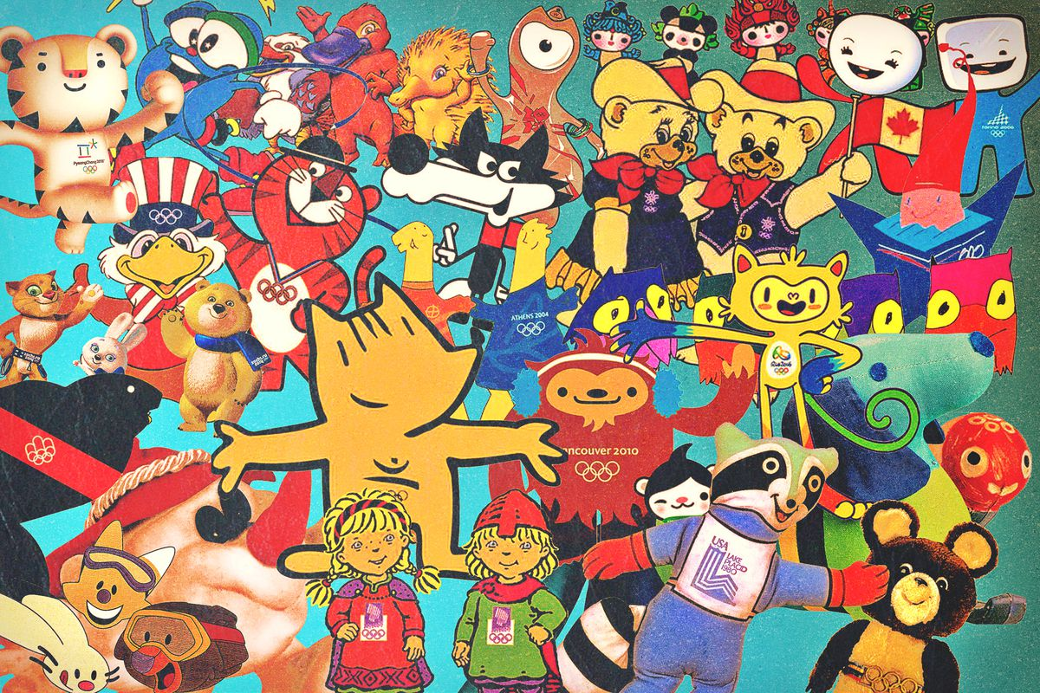

Slide 7


Slide 8
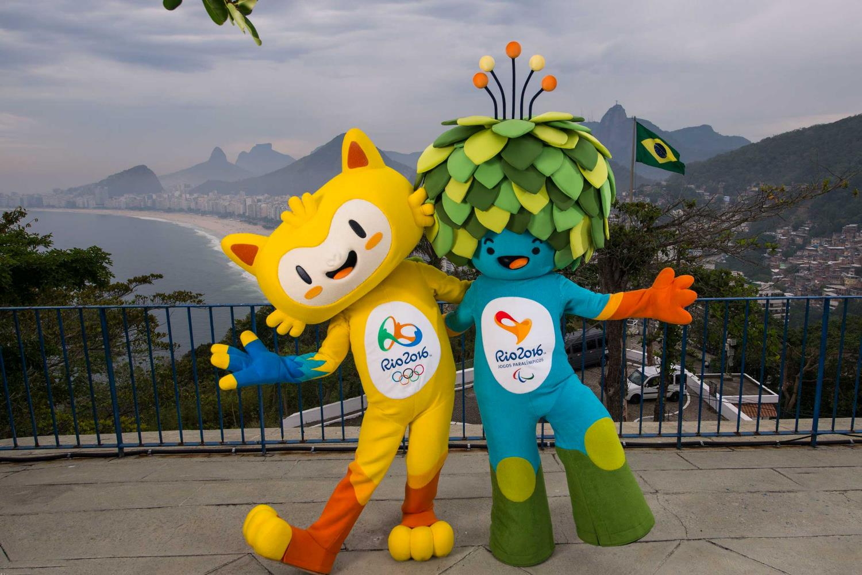

Slide 9
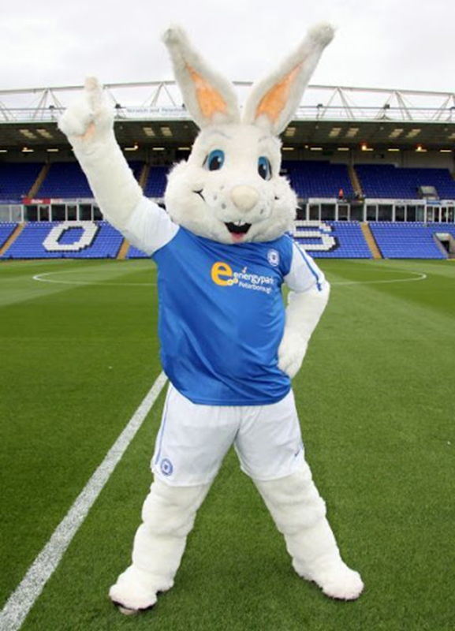

Slide 10
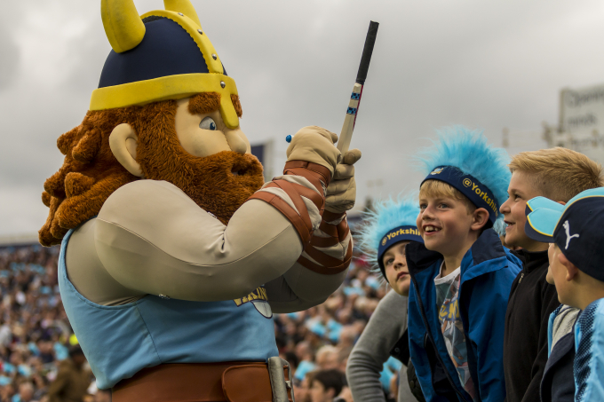

Slide 11
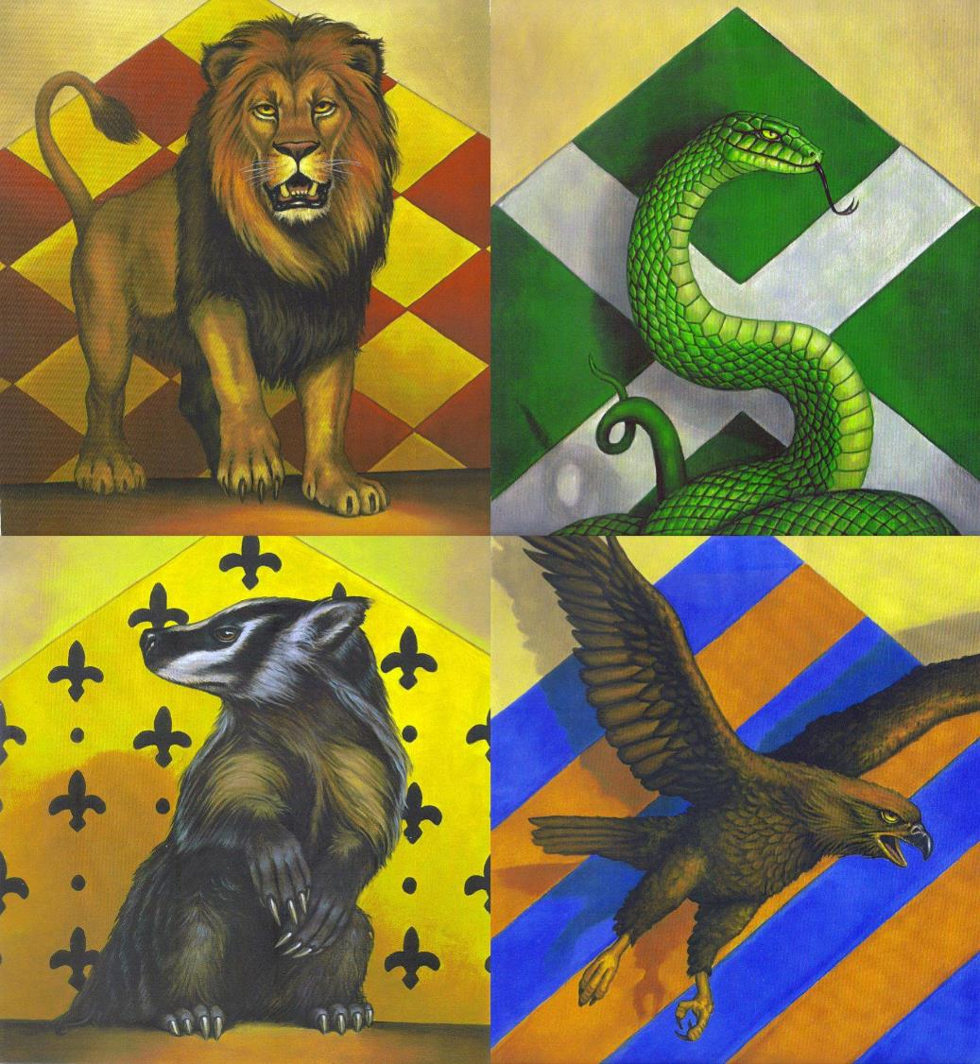

Slide 12
HOW DO I HAND IT IN?
CREATE an A4 drawing of your character using predominantly the colour of your HOUSE
Write your name and form group on your work
DEADLINE 19th OCTOBER
SUBMIT YOUR FINAL PIECE VIA
EMAIL to housemascot@bourneacademy.org
Please include your full name on the work
As a jpeg/ word doc/ psd
Or as a hard copy/drawing to your YEAR LEAD in
G block there will be a box to drop it in to.

Slide 13
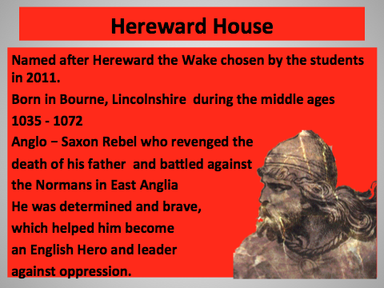
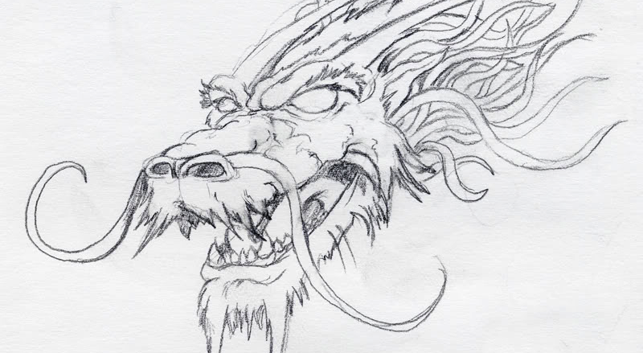
HEREWARD

Slide 14
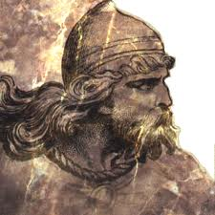
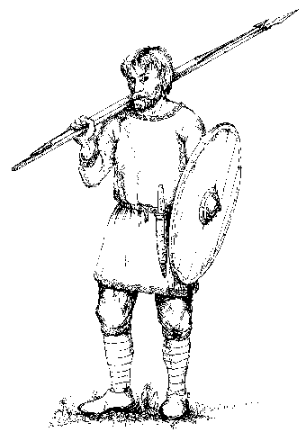
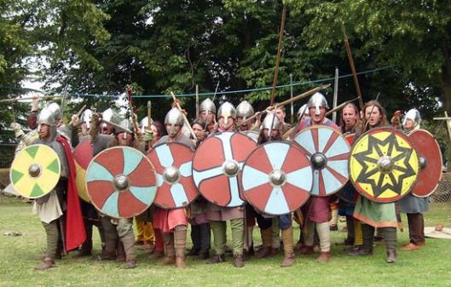
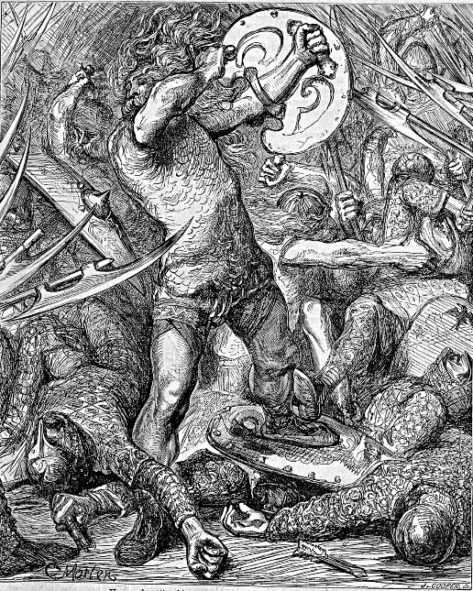
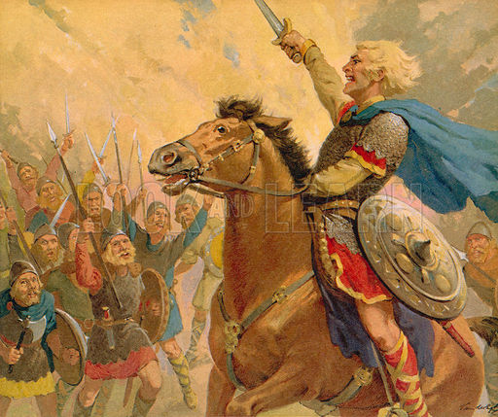

Slide 15
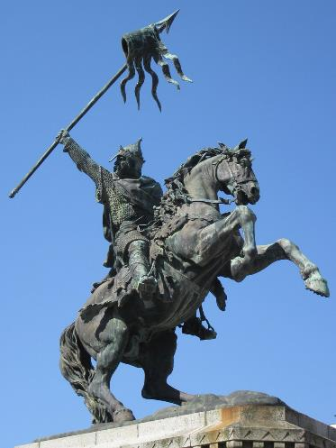
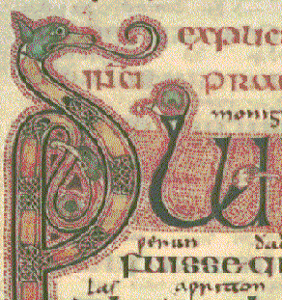
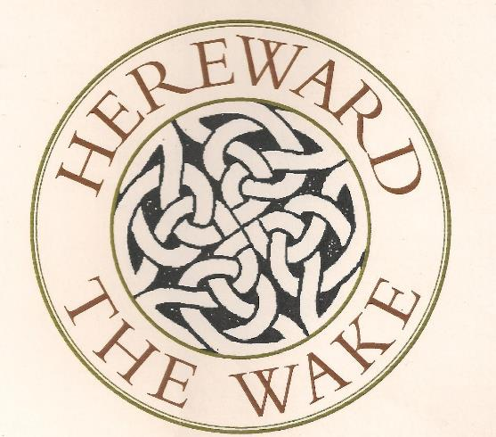
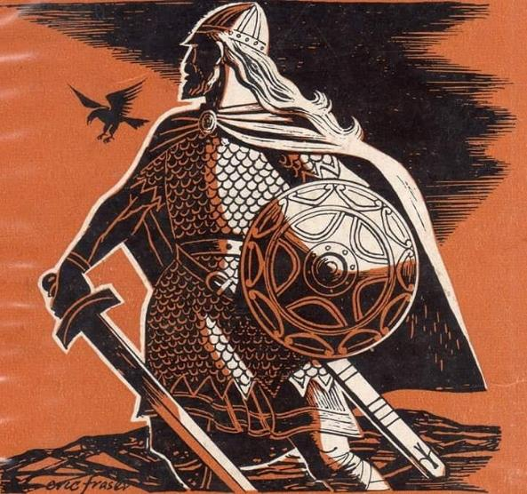
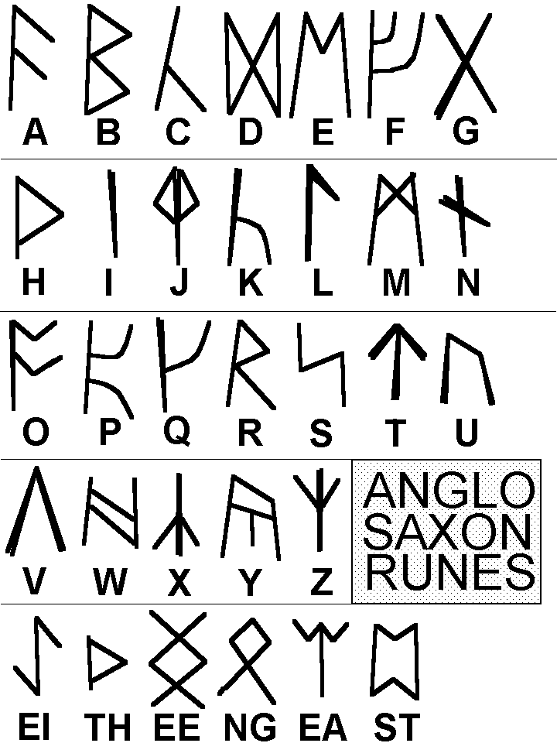

Slide 16
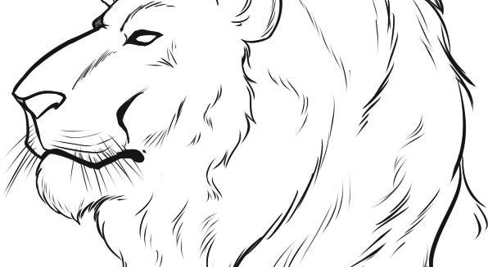
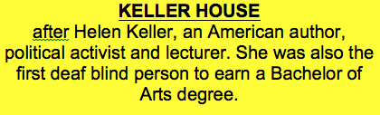
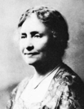
KELLER
Helen Keller was an American Author, political activist and author. After becoming the first deaf blind person to earn a Bachelor of Arts degree, she spent her life helping others. In all she visited nearly 40 countries, inspiring others with talks about her life experiences and achievements. Although Helen died in 1968, her influence continues through Helen Keller International, a foundation devoted to ”saving and improving the sight and lives of the world’s vulnerable”.

Slide 17
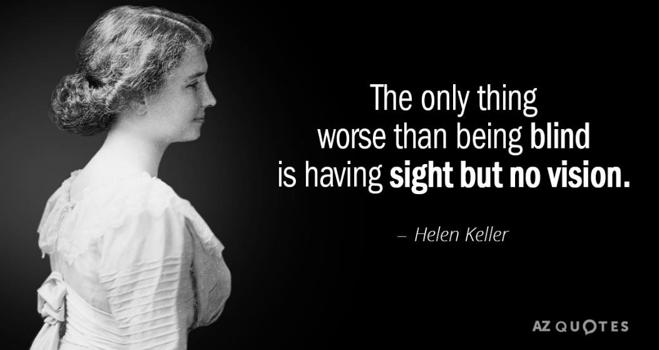

Slide 18
Helen Keller championed human rights.
Graduation Day
Her influence was widespread.

Slide 19
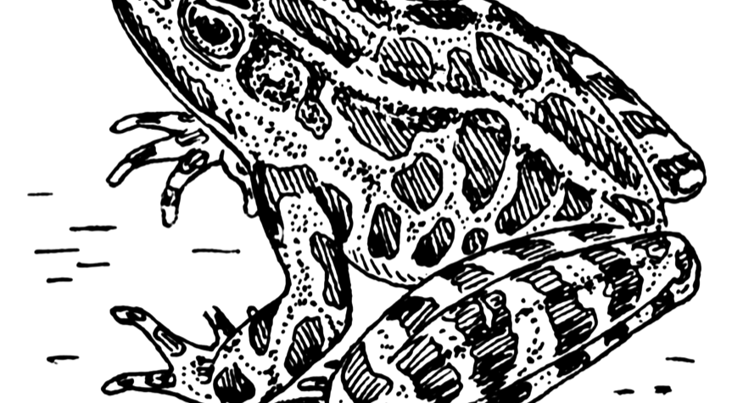
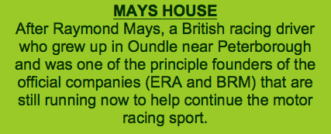
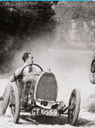
MAYS

Slide 20



In Mays House we strive to be like a SUPERHERO….
Support/help others
Never give up/A fighting spirit
Always strive to be the best
Courage to face their fears
Motivated and Sense of Responsibility
Commitment and Honesty

Slide 21

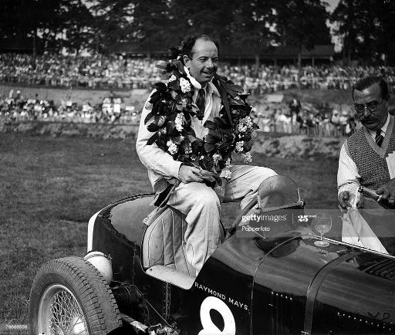
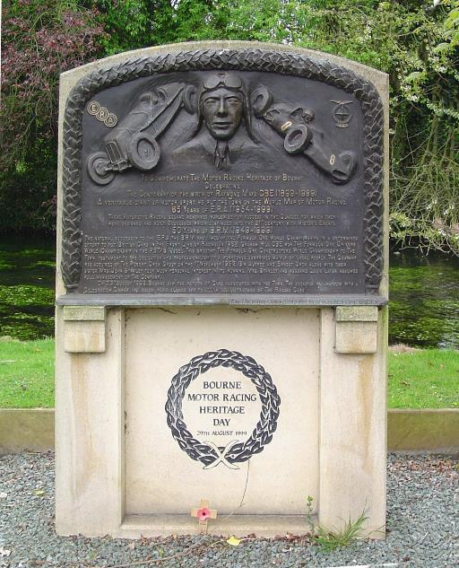


Slide 22
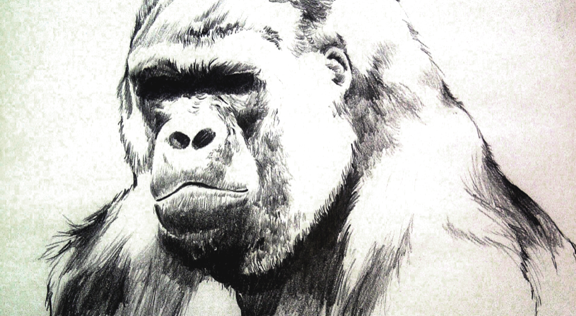
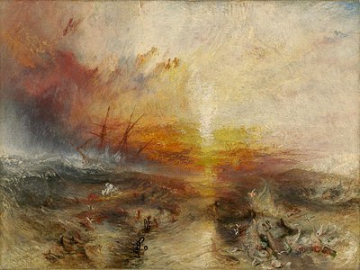
TURNER
William Turner – 1775 -1851
His full name is Joseph Mallory William Turner
Regarded as one of the countries greatest artists, his legacy being 550 oil paintings, 2,000 water colours and 30,000 incomplete works
He is part of the Romantic era and and is renowned for his imaginative landscapes and turbulent sea scapes (example opposite).
His work is now seen as more traditional, however his influence on contemporary artists is still evident to this day. Remarkable given he died c.170 years ago.
The famous Turner Prize for visual arts which is hosted by the Tate Gallery in London is named in his honour.
He status as a great British artist is also marked by his burial in St Paul’s Cathedral

Slide 23
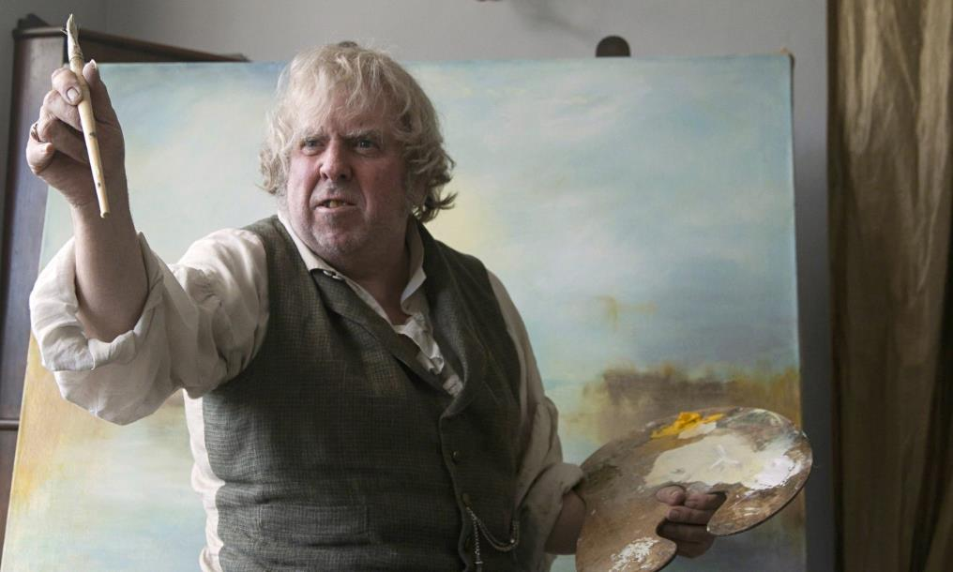
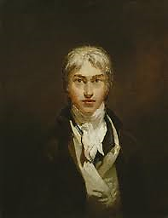

Slide 24
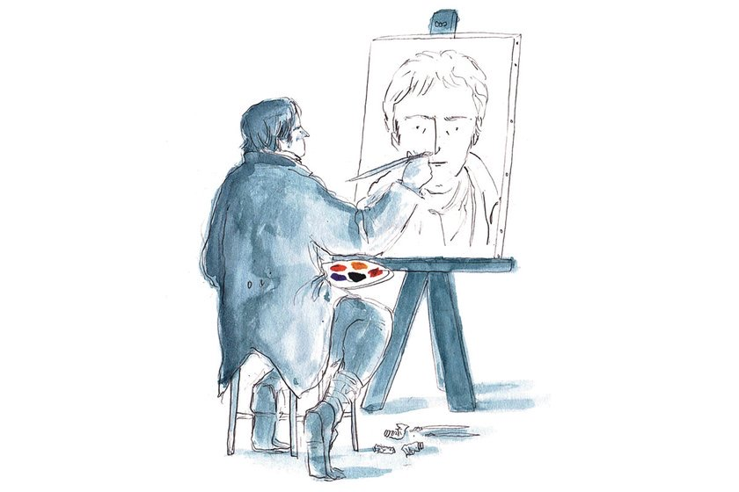
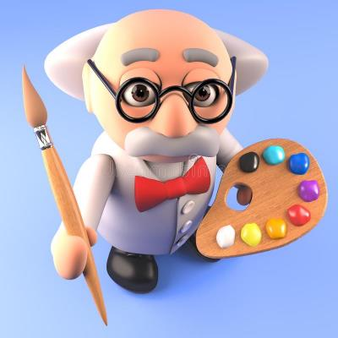

Slide 25
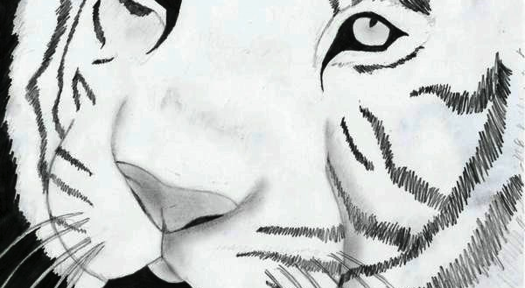
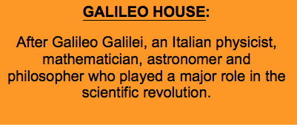
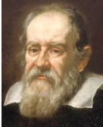
GALILEO

Slide 26
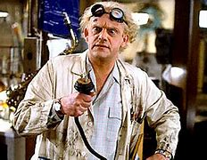

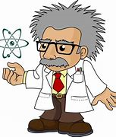
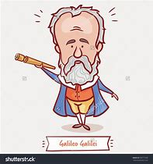

Slide 27
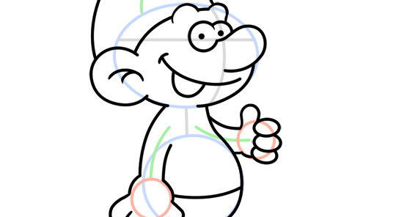
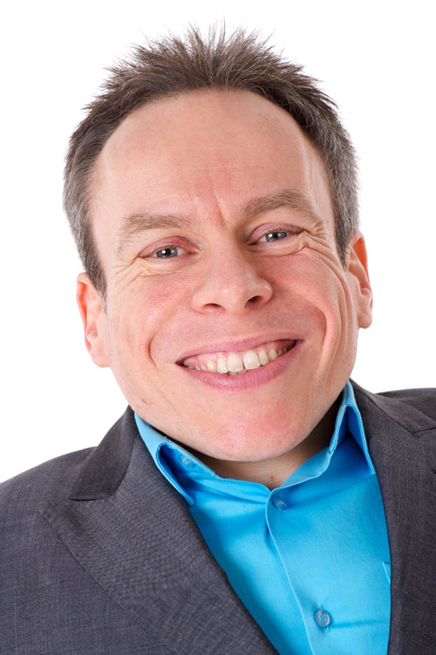
WARWICK
Why Warwick?
Warwick Davis is an English actor, television presenter, writer, director, producer and comedian. He lives locally in Peterborough and was born with Spondyloepiphyseal dysplasia congenita, an extremely rare form of dwarfism. He runs the charity Little People UK which gives hope to all young people with dwarfism.
Warwick Image:

